Slide 1
Centrality Beyond Degree: Eigenvector (C_{Eig})
A node that is directly and indirectly connected to other nodes of high degree has the highest eigenvector centrality!
s
e
q
b
g
p
m
d
l
a
h
i
j
f
k
n
o
c
r

Slide 2
Centrality Beyond Degree: Eigenvector (C_{Eig})
In this graph, this node has the highest eigenvector centrality!
s
e
q
b
g
p
m
d
l
a
h
i
j
f
k
n
o
c
r

Slide 3
Centrality Beyond Degree: Eigenvector (C_{Eig})
C_{deg}(e) = 3
Node d is directly connected to other nodes that have high degree centrality (for this graph)
s
C_{deg}(b) = 4
e
q
b
g
C_{deg}(g) = 5
p
m
d
l
a
h
i
j
f
k
C_{deg}(a) = 3
C_{deg}(f) = 4
n
o
c
r

Slide 4
Centrality Beyond Degree: Eigenvector (C_{Eig})
Node d is also indirectly connected to other high-degree nodes via relatively short paths
s
e
q
b
g
p
C_{deg}(j) = 7
m
d
l
a
h
i
j
f
k
n
o
c
r

Slide 5
Centrality Beyond Degree: Eigenvector (C_{Eig})
It is called “eigenvector” because it is calculated using a matrix algebra called eigenvalue decomposition to rank each node according to whether they are connected to well-connected others.
s
e
q
b
g
p
C_{deg}(j) = 7
m
d
l
a
h
i
j
f
k
n
o
c
r

Slide 6
Centrality Beyond Degree: Eigenvector (C_{Eig})
Eigenvector centrality was discovered by a Professor of sociology at UCLA! (Bonacich 1978)
s
e
q
b
g
p
C_{deg}(j) = 7
m
d
l
a
h
i
j
f
k
n
o
c
r

Slide 7
a | b | c | d | e | f | g | h | i | j | k | l | m | n | o | p | q | r | s
12.6 | 16.1 | 5.7 | 19 | 13.6 | 14.1 | 18.1 | 8 | 5.7 | 6.6 | 3.5 | 3.3 | 2.7 | 3.8 | 2.7 | 4 | 0.7 | 2.1 | 0.2
Eigenvector centrality was discovered by a Professor of sociology at UCLA! (Bonacich 1978)
s
e
q
b
g
p
C_{deg}(j) = 7
m
d
l
a
h
i
j
f
k
n
o
c
r

Slide 8
Types of centrality measures and interpretations
How well is a node directly connected to others?
  Degree, indegree, outdegree: Based on the number of one-step connections from that node to all others
How well is a node indirectly connected to others?
  Closeness: Based on the number shortest paths that begin with that node and reach the others
How well can a node serve as an intermediary between other nodes?
  Betweenness: Based on the proportion of shortest paths between all other pairs of nodes including that node
How well is node connected to highly connected others?
  Eigenvector: Based on the direct and indirect connections of that node to other central nodes

Slide 9
Graph Centralization

Slide 10
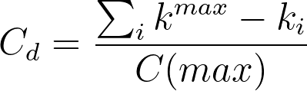
Graph Centralization
Degree Centralization compares an observed network to one that is maximally centralized (the star graph of the same order)
A
A
E
B
C
E
B
C
D
D
A | B | C | D | E
4 - 1 | 4 - 4 | 4 - 1 | 4 -1 | 4 - 1
3 | 0 | 3 | 3 | 3
k^{max} =4
A | B | C | D | E
4 - 3 | 4 - 4 | 4 - 3 | 4 -3 | 4 - 3
1 | 0 | 1 | 1 | 1
k^{max} =4
Maximally Centralized Network (N = 5)
Observed Network
(N = 5)

Slide 11
Graph Centralization
It is given by the sum of the differences between maximum degree and the degree of each node in the observed network to the same number in the star graph of the same size
A
A
E
B
C
E
B
C
D
D
A | B | C | D | E
4 - 1 | 4 - 4 | 4 - 1 | 4 -1 | 4 - 1
3 | 0 | 3 | 3 | 3
k^{max} =4
Sum of differences: 12
A | B | C | D | E
4 - 3 | 4 - 4 | 4 - 3 | 4 -3 | 4 - 3
1 | 0 | 1 | 1 | 1
k^{max} =4
Sum of differences: 4
Maximally Centralized Network (N = 5)
Observed Network
(N = 5)

Slide 12
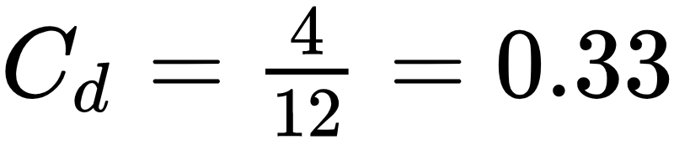
Graph Centralization
It is given by the sum of the differences between maximum degree and the degree of each node in the observed network to the same number in the star graph of the same size
A
A
E
B
C
E
B
C
D
D
A | B | C | D | E
4 - 1 | 4 - 4 | 4 - 1 | 4 -1 | 4 - 1
3 | 0 | 3 | 3 | 3
k^{max} =4
Sum of differences: 12
(n-1)*(n-2)
A | B | C | D | E
4 - 3 | 4 - 4 | 4 - 3 | 4 -3 | 4 - 3
1 | 0 | 1 | 1 | 1
k^{max} =4
Sum of differences: 4
Maximally Centralized Network (N = 5)
Observed Network
(N = 5)

Slide 13
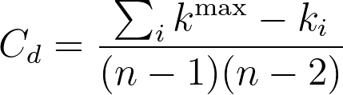
Graph Centralization
It is given by the sum of the differences between maximum degree and the degree of each node in the observed network to the same number in the star graph of the same size
A
A
E
B
C
E
B
C
D
D
A | B | C | D | E
4 - 1 | 4 - 4 | 4 - 1 | 4 -1 | 4 - 1
3 | 0 | 3 | 3 | 3
k^{max} =4
Sum of differences: 12
(n-1)*(n-2)
A | B | C | D | E
4 - 3 | 4 - 4 | 4 - 3 | 4 -3 | 4 - 3
1 | 0 | 1 | 1 | 1
k^{max} =4
Sum of differences: 4
Maximally Centralized Network (N = 5)
Observed Network
(N = 5)

Slide 14
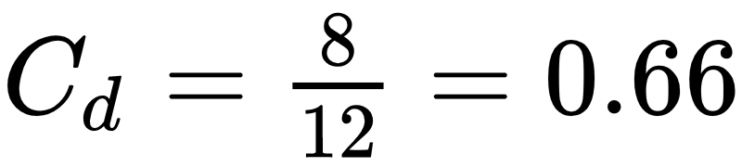
Graph Centralization
The closest the graph centralization is to 1.0 the closer the observed graph is to the star graph
A
A
E
B
C
E
B
C
D
D
A | B | C | D | E
4 - 1 | 4 - 4 | 4 - 1 | 4 -1 | 4 - 1
3 | 0 | 3 | 3 | 3
k^{max} =4
Sum of differences: 12
(n-1)*(n-2)
A | B | C | D | E
4 - 2 | 4 - 4 | 4 - 2 | 4 -2 | 4 - 2
2 | 0 | 2 | 2 | 2
k^{max} =4
Sum of differences: 8
Maximally Centralized Network (N = 5)
Observed Network
(N = 5)

Slide 15
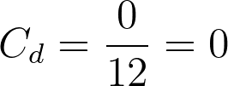
Graph Centralization
The opposite of the star graph is the regular graph. Everyone has the same degree and centralization is zero!
A
A
E
B
C
E
B
C
D
D
A | B | C | D | E
4 - 1 | 4 - 4 | 4 - 1 | 4 -1 | 4 - 1
3 | 0 | 3 | 3 | 3
k^{max} =4
Sum of differences: 12
(n-1)*(n-2)
A | B | C | D | E
4 - 4 | 4 - 4 | 4 - 4 | 4 - 4 | 4 - 4
0 | 0 | 0 | 0 | 0
k^{max} =4
Sum of differences: 0
Maximally Centralized Network (N = 5)
Observed Network
(N = 5)

